Slide 1
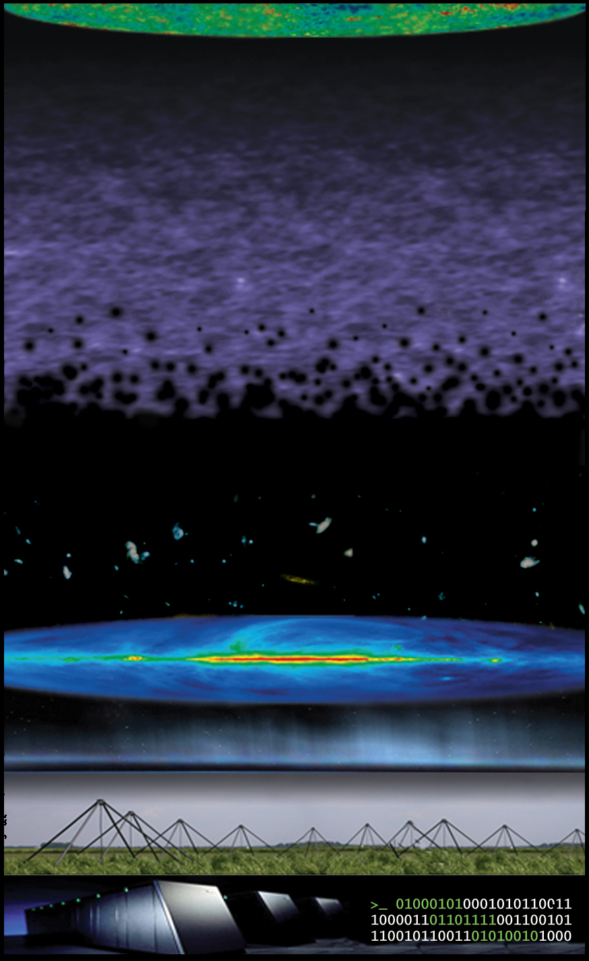
13.7 billion years
(z~1100)
Light-Travel Time
13.2 billion years
(z~10)
LOFAR – Epoch of Reionization
key science project
extragalactic foregrounds
11.5 billion years
(z~3)
Cosmic Microwave Background
13.7 billion years
(z~1100)
galactic foregrounds
1 thousand years
(z~0)
Light-Travel Time
ionosphere
0.6 milliseconds
LOFAR
0.4 milliseconds
13.2 billion years
(z~10)
Epoch of Reionization
21 cm
extragalactic foregrounds
11.5 billion years
(z~3)
Galactic foregrounds
1 thousand years
(z~0)
ionosphere
0.6 milliseconds
1-2 m
LOFAR
0.4 miliseconds
supercomputer in Groningen
0 seconds
According to the Big-Bang cosmology, our Universe went though a number of important stages during its evolution. One of these important cosmic stages, known as the Epoch of Reionization (EoR), occurs about 400 million years after the Big-Bang. During this cosmic stage, the first radiation emitting astrophysical sources were formed and their radiation transformed hydrogen in the Universe from neutral to ionized state.
The EoR could be traced in space and time using relic radio emission that will be observed, for the first time, by the LOFAR (Low Frequency Array) radio telescope. The aim of the LOFAR-EoR project is to uncover the EoR and determine when and how the Universe started forming its first astrophysical objects. LOFAR will reveal how the ionizing radiation from these objects permeate and fill the whole Universe. The EoR is related to many fundamental questions in cosmology, galaxy formation, and the formation of first quasars and stars.

